Slide 1


What we talk about when we talk about surgery
Margaret “Gretchen” Schwarze, MD, MPP, FACS
Morgridge Endowed Professor of Vascular Surgery
University of Wisconsin-Madison
Department of Surgery, Department of Medical History and Bioethics

Slide 2
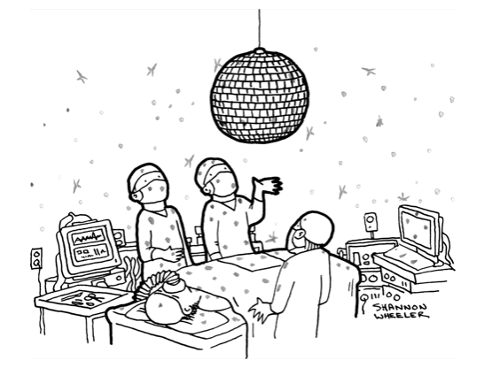
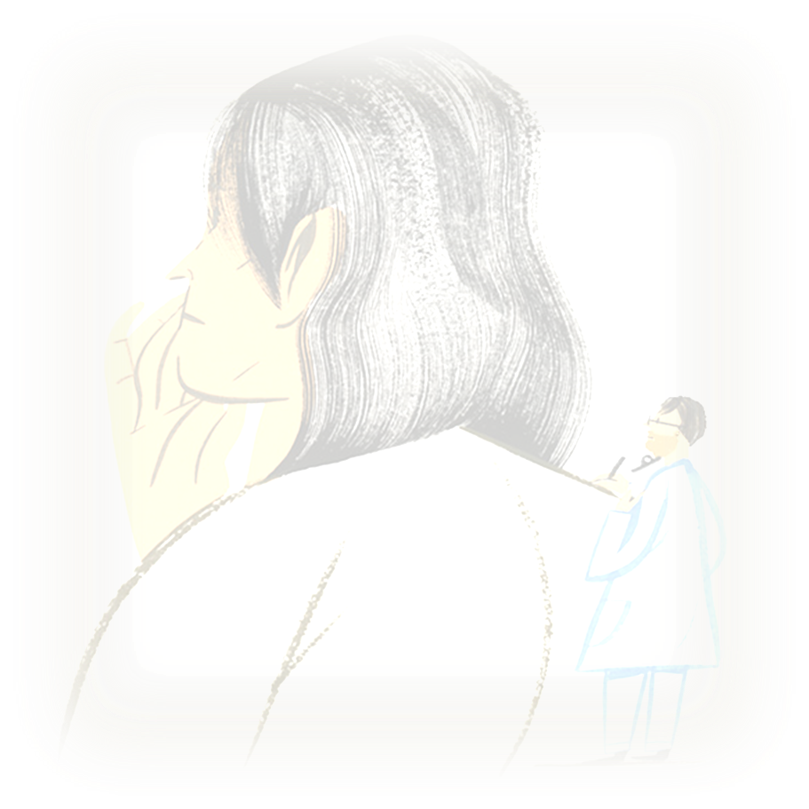
DISCLOSURES:
Current Funding for Research
NIH: R01AG065365
NIH: R01AG078242
NIH: K24AG073476
Other (spouse)
Mezlight LLC
Alexis Bio
Notes:
Not just for surgeons, but for all clincians… because we all need to collaborate with patients and families about how best to take care of them…

Slide 3
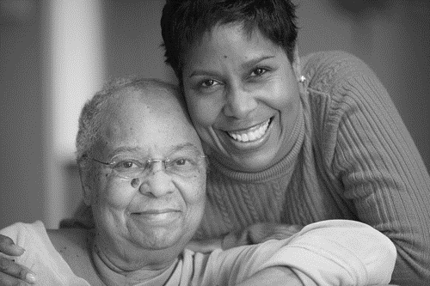
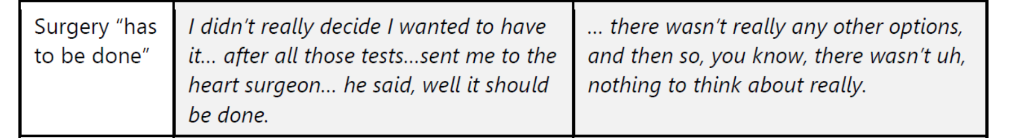
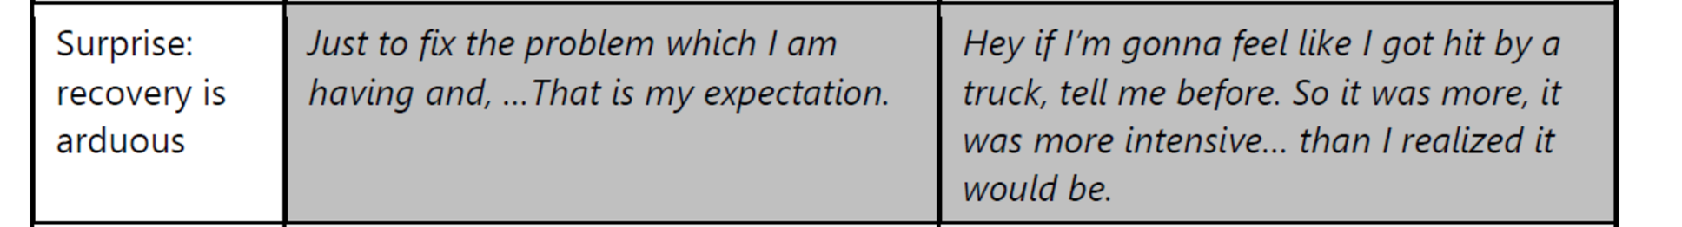


Slide 4



Patients want to participate, they often don’t know how
Surgeon endorsement
Increased patient self-efficacy in communication
MD helps compare treatment options
Patient and Family
QPL
Activated
Patient and Family
Inter-vention
OPTION⁵
PEPPI & HCCQ
Patient
reflection
Question asking

Slide 5
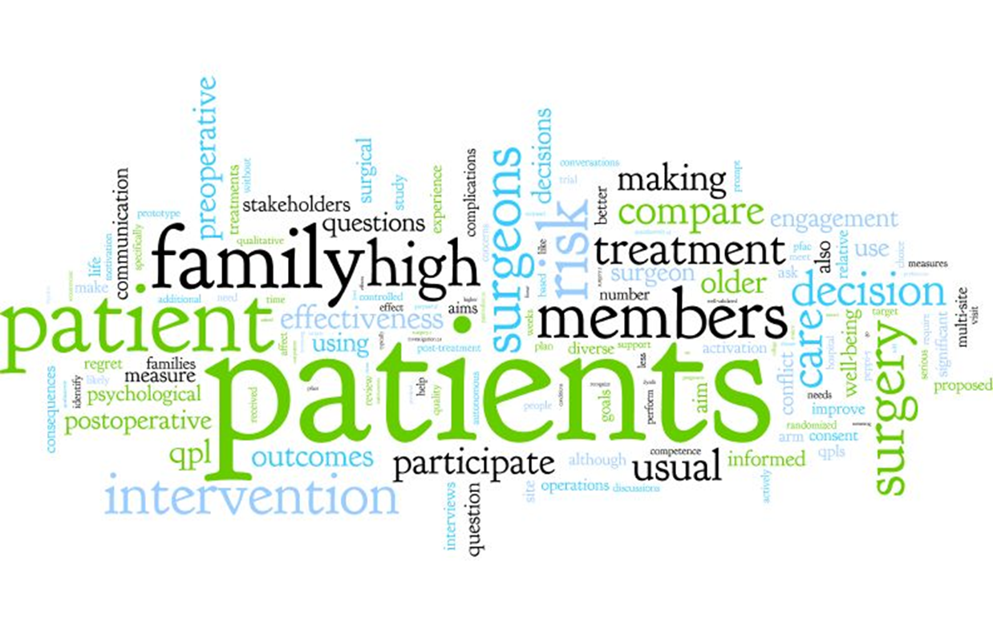
"The single biggest problem with communication is the illusion that it has taken place."
-George Bernard Shaw

Slide 7

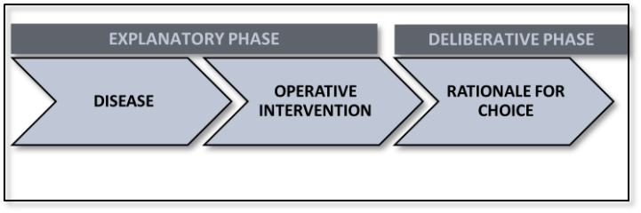
“This is your problem and this is the operation I have to fix it”
Notes:
Over the past 10 years in my lab we have recorded more than 500 conversations between surgeons and patients
So, how are we doing?
Well, we all do it, pretty much the same way….
We start with an explanation…
We talk about the disease – we show films, cat scans – we say, “this is you sliced like bread” – how many people say that? How many people say sliced like ham? We see ham too…There’s more bread than ham in my dataset…
We say this is your liver and here is a big tumor in it, and I can take it out….
We say, this is your problem and this is the operation I have to fix it.
Even though we go on to talk about whether we should do that – perhaps the problem is too broken to fix, or not broken enough, or there are risks, and you won’t be the same after surgery.
We spend a ton of time describing how and we rarely explain why.

Slide 8
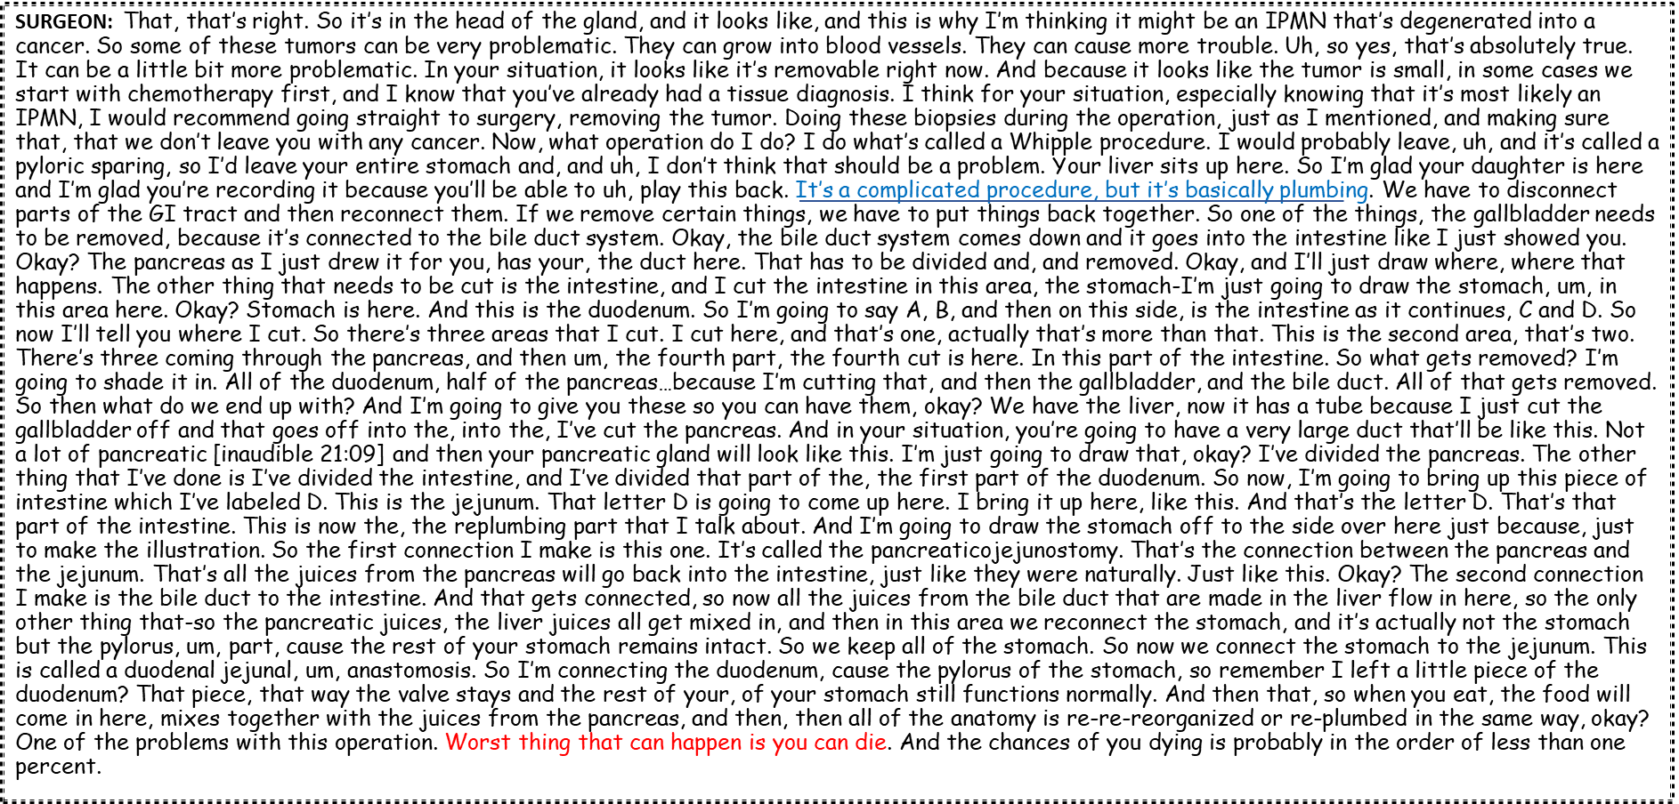
Notes:
This is un-edited data from my lab, this is a surgeon working really hard to very brilliantly describe a whipple
… and I want to be clear that this is typical, we all do this…. As if it were very important
But it’s not so clear to me that this is the kind of information that a) patients can absorb or b) it will help them make a decision….
It’s like if your plumber came to fix your toilet and spent the majority of his time explaining to you how all those little parts in the back worked and how he might repair them.
While I can imagine some people might want to know how their toilet works this type of information will not help you decide what to do…. because if you are going to get your toilet fixed your plumber dam well needs to tell you how well it is going to work, how long its going to last and what’s it going to cost.
Rather than telling people what we are going to do in the operating room, we need to tell them what we are hoping to achieve if we operate

Slide 9
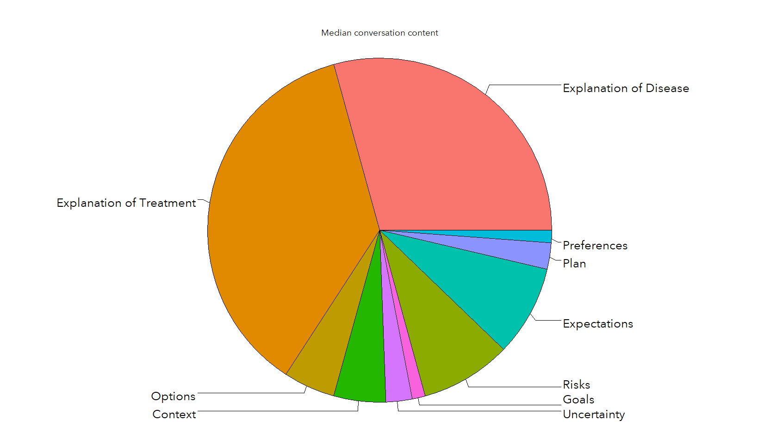
Explanation of Disease and Explanation of Treatment Consumes the Decision-Making Conversation
Stalter L, et. al, MDM, April 2023

Slide 10
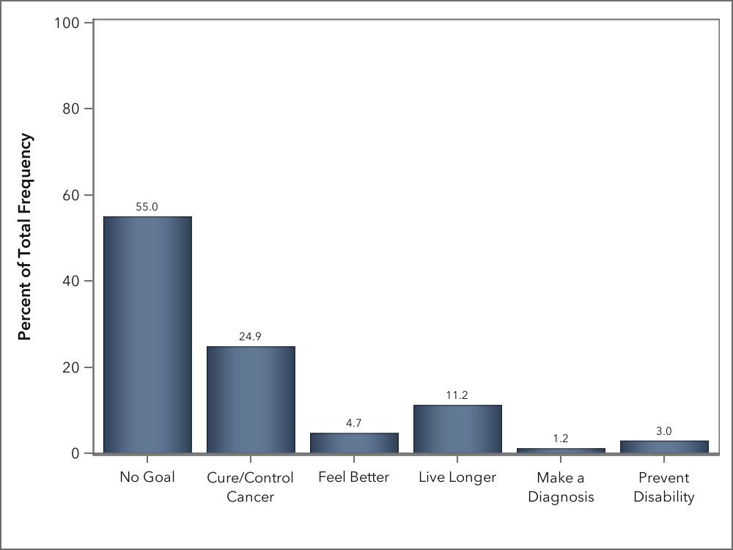
In >75% of conversations no goal or cure/control cancer was the only goal mentioned
Stalter L, et. al, MDM, April 2023

Slide 11
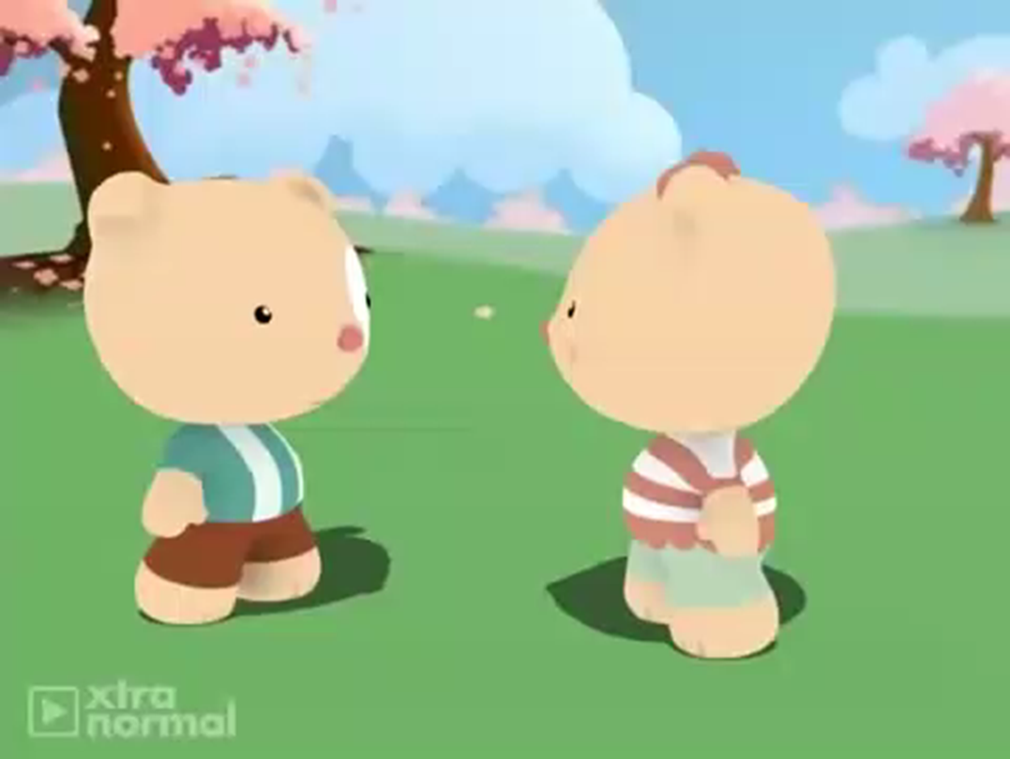
In 89% of conversations “fix-it” was used to describe treatment
Notes:
I will often start an operation by asking the medical student or the resident “why are we doing this case?”
And invariably they will say “there’s a blockage” or “this aneurysm meets criteria”… I keep asking but …. It often takes a long time to get to “prevent limb loss” or “to make her feel better”
Somehow we have internalized this notion of fixing to the point where we have forgotten about the person attached to it….
[[play vid]]]
For those of you who have not seen this, the anesthesia bear gets more and more upset…. She asks more about the patient and receives few answers… finally the surgeon says “she has something I have not seen before, asystole….”
And it’s really funny…. But the reason it’s funny is because there is truth behind it….

Slide 12
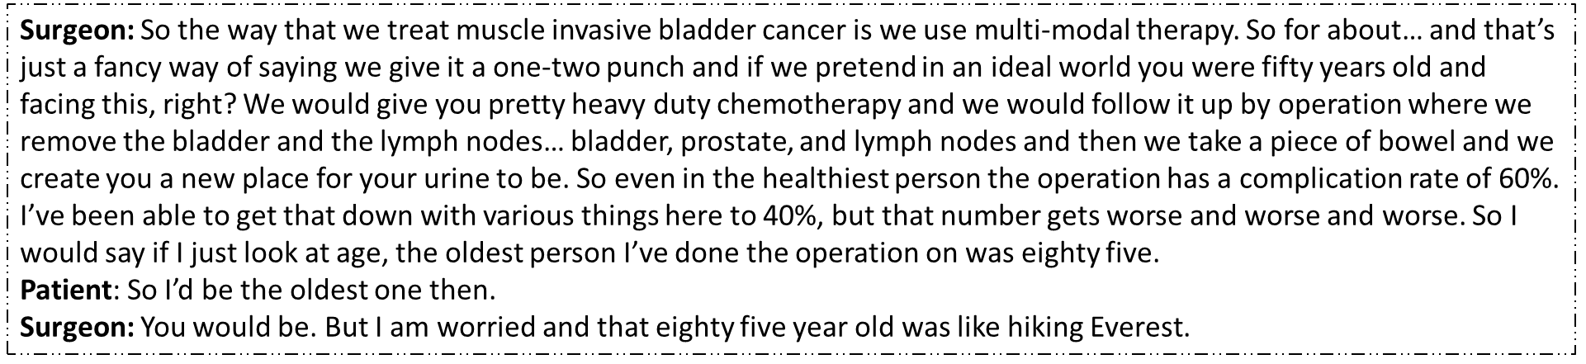
“Non-choice choices”

Slide 13
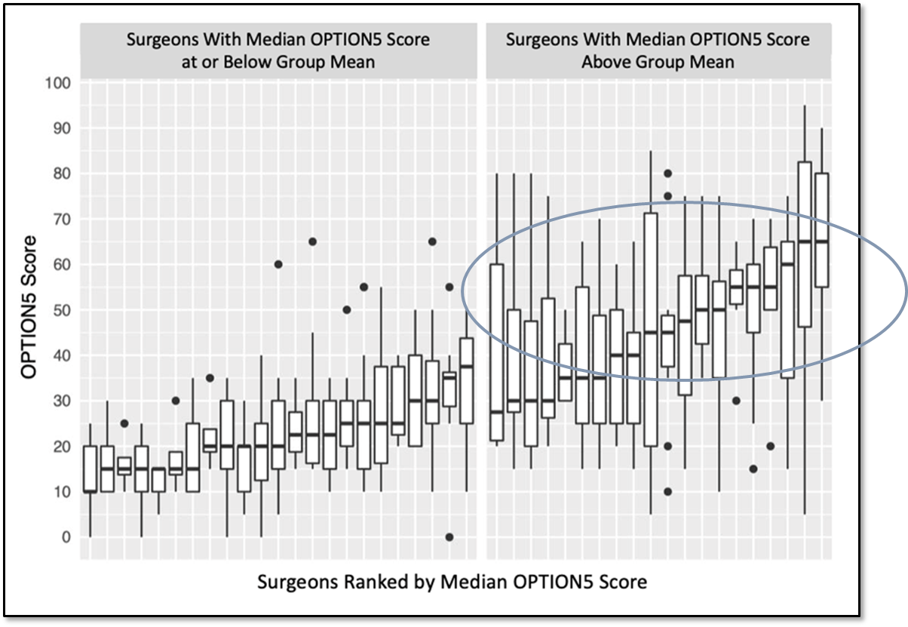
Baggett N, et. al, JAMA Surgery, February 2022
“Telling clinicians to ‘offer patients more choice’ may not achieve its objective.”
Torien M., et. al, “Offering Choices…”Epilepsy Behavior, 2021

Slide 14

CORE FRAMEWORK for INFORMED CONSENT
Patient understanding
of disease and treatment
Risks
Reportable complications
Permission to proceed
  Bleeding
  Infection
  Heart attack
  Stroke
  Death
Alternatives
Non-choice choices
Explanation
of disease
Explanation
of treatment
Benefit = The problem will be fixed

Slide 15
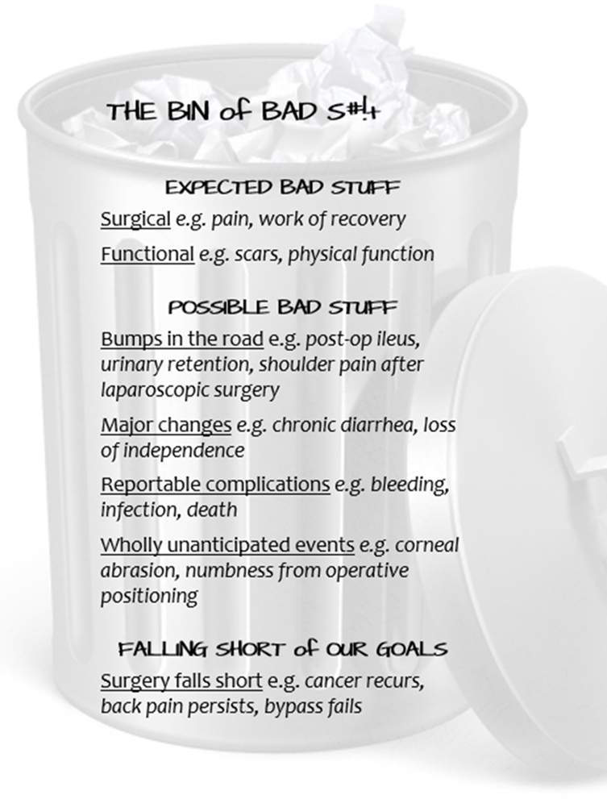
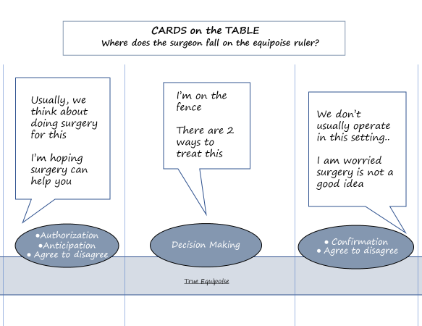

Live longer
Feel better
Prevent disability
Make a diagnosis
CONTEXT
GOALS
DOWNSIDES
DELIBERATE
Schwarze ML, et. al, “Innovations in Surgical Communication 1-4,” JAMA Surgery, August 2023

Slide 16
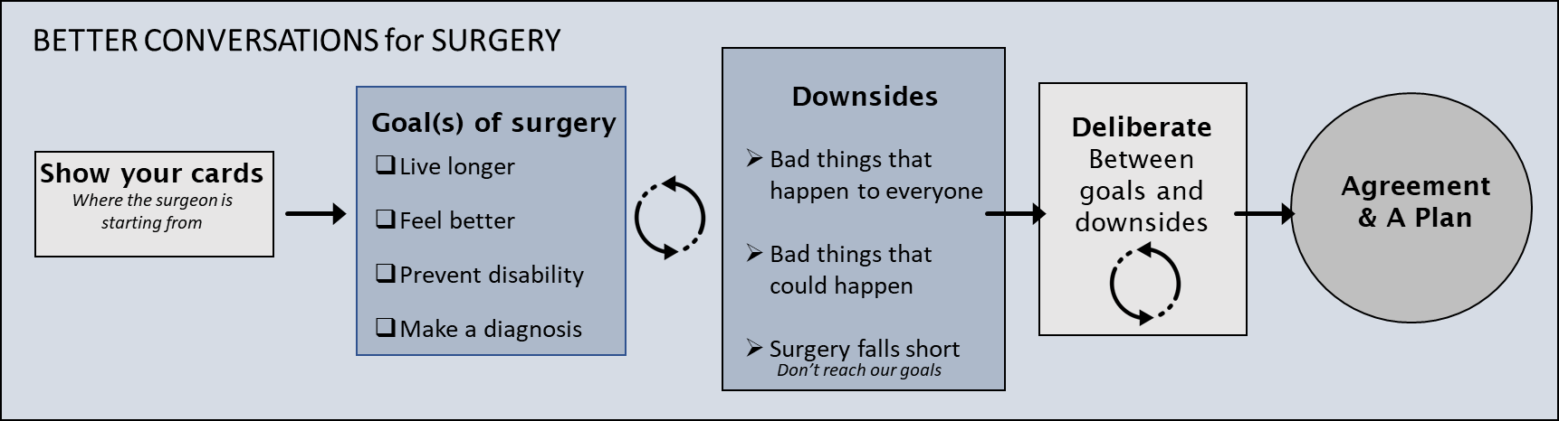

Slide 17
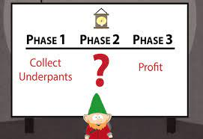

Slide 18
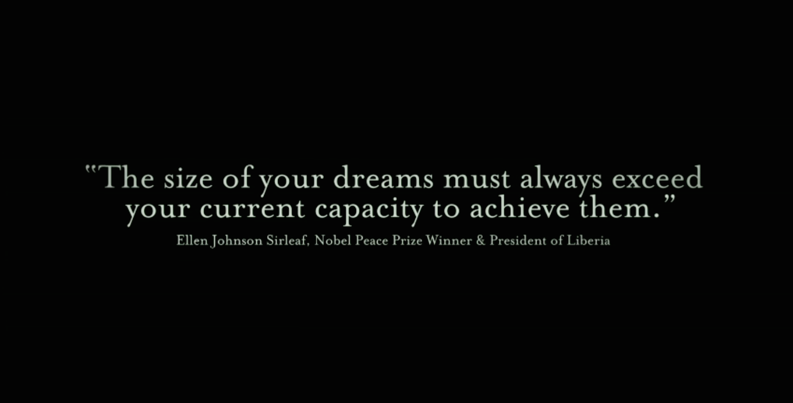
Notes:
Thank you all so very much, this is truly an honor.

Slide 19



Thank you!
schwarze@surgery.wisc.edu
Additional Resources:
https://patientpreferences.org/
https://tinyurl.com/hfej6hv
Notes:
Dr. Schwarze will discuss her empirical work on patient-surgeon communication, including exploration of surgical informed consent, shared decision making and interventional strategies to support surgeon-patient communication.

